Slide 1


Student performance factors submitted by resmi a

Slide 2
Introduction
Students’ performance is not only influenced by the talent of nature but also several factors that are involved for better performance. For the social and economic improvement of the society and nation as a whole, it is mandatory to provide quality education for our children. This study aims to assess and explore school and students related factors that are affecting the student secondary school performance This dataset provides a comprehensive overview of various factors affecting student performance in exams. It includes information on study habits, attendance, parental involvement, and other aspects influencing academic success.

Slide 3
reference
https://www.Kaggle.com
https://www.kaggle.com/datasets/lainguyn123/student-performance-factors

Slide 4
Dataset used

Slide 5
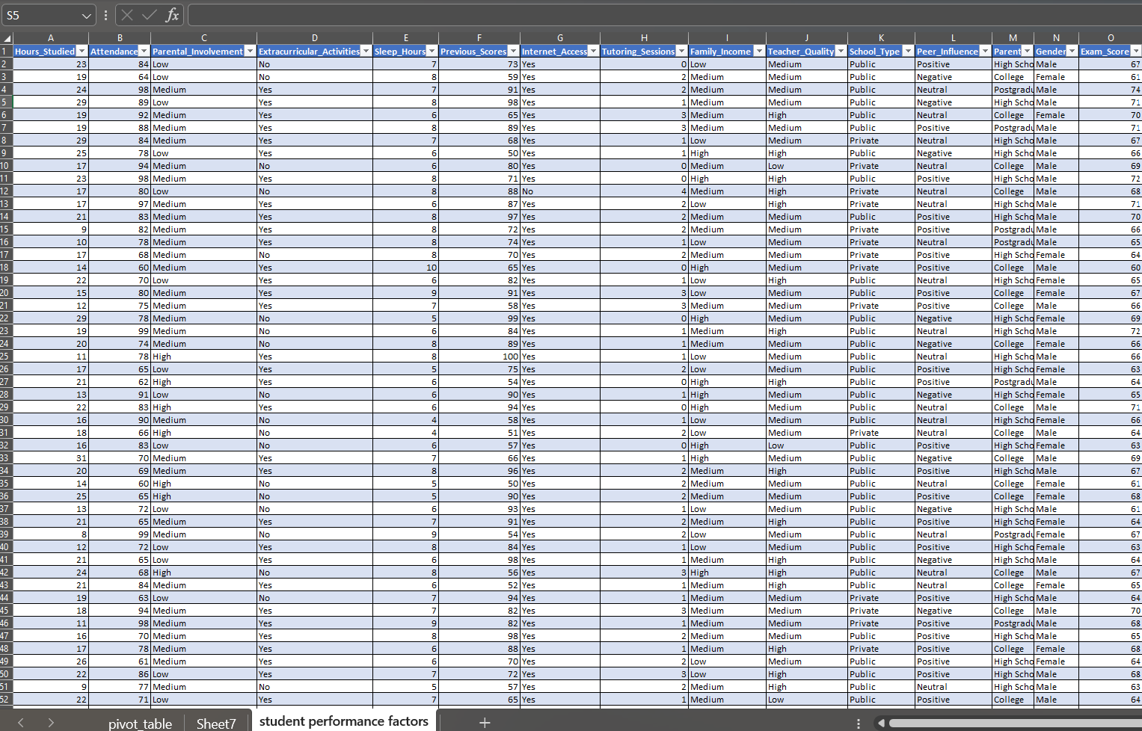

Slide 6
Description
Hours_studied: Number of hours spent study
Attendance: Percentage of class attended
Parental involvement: Involvement of parents
Extra curricular activities: Participation in extra curricular activities
Sleep hours: Average number of hours sleep per night
Previous score: Score of previous exam by the student
Internet access: Availability of internet access
Tutoring sessions: Number of tutoring sessions attended per month
Family income: Family income level
Teachers Quality: quality of teachers
Peer influence: Influence of peers on academic performance
Gender: Gender of the student
Exam score: Final exam score

Slide 7
Criterias used
Sum of exam score based on hours studied: Column chart
Sum of exam score based on parental involvement: Pie chart
Sum of exam score based on attendance: Bar chart
Sum of exam score based on peer influence: Bar chart
Teachers quality based on school type: Stacked bar chart
Sum of exam score and previous score based on internet access: Doughnut pie chart

Slide 8
Dashboard using these criterias

Slide 9
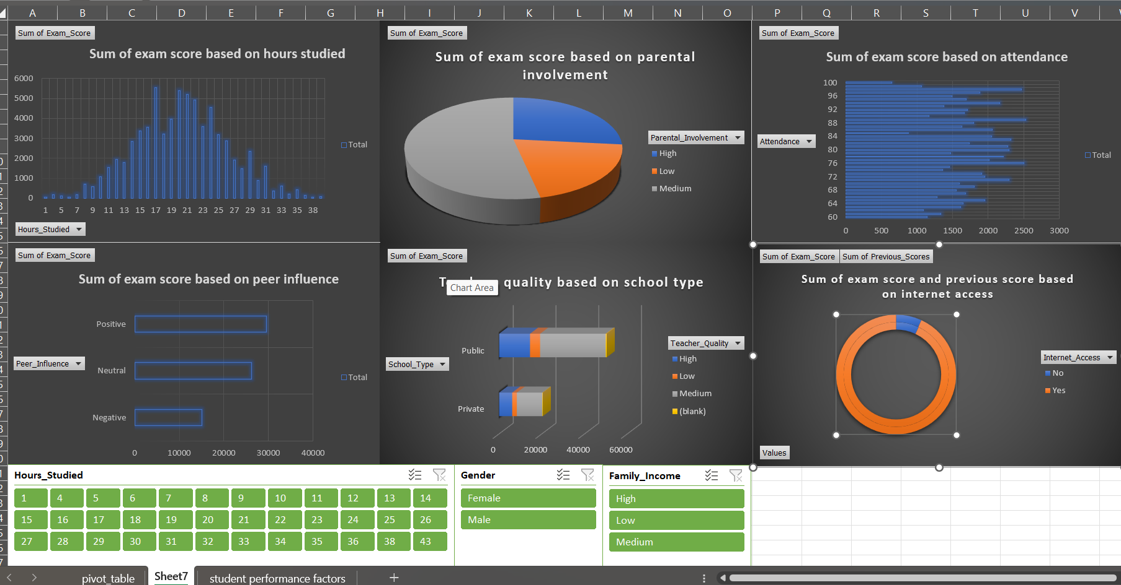

Slide 10
Thank You

